Slide 1

A.R.T.E.M.I.S.
Adaptive Reasoning, Task Execution and
Multi-agent Intelligence System
“An AI assistant that stays inside the lines.”
Presented by
  Hashir Rauf (23L-2572)
  Syeda Doureesha Batool (23L-2651)
  Hira Khalid (23L-2594)

Slide 2
Three questions. One bounded answer.
WHY
WHAT
HOW
Problem + research
Solution + requirements
Architecture + security
WHY: Interrupted work costs time, and capable assistants demand broad access
WHAT: A bounded assistant that works only in folders you grant
HOW: Safety built into the structure, not promised by the model

Slide 3
Knowledge work is interrupted work
Routine friction compounds every time context is lost.
1 Context lost after interruption
82%
of 374 respondents do multi-file work daily or several times a week
2 Folders become disorder
3 Routine work costs time
4 Trust blocks automation
5 Broad access risks control

Slide 4
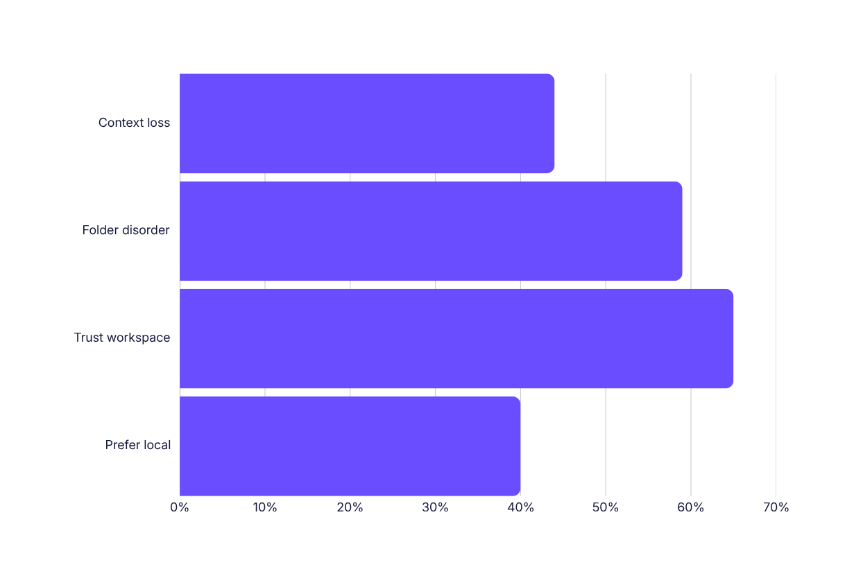
The signal is consistent
374 valid responses · 13 interviews · 81% students · 13% developers
42%
lose >1 hour/week
65%
workspace-only trust · mean 3.8/5

Slide 5
Design follows behaviour—not assumptions
Four findings became four product decisions.
192 / 182
65%
Approval split → Configurable gates
Continue after one mistake → Undo > perfection
27%
10 / 13
Quit: habit mismatch → Effortless onboarding
Interview support → Deletable memory

Slide 6
Can restriction increase usefulness?
Hypothesis: narrower scope increases trust—and adoption.
Granted folders
Preview · approve
Undo full plan
Visible memory

Slide 7
Local-first changes the access bargain
Capable without broad access. Useful without uploading personal data.
SDG 9.5
Industry, innovation & infrastructure
77%
respondents already use AI assistants
SDG 8.2
Productivity and decent work

Slide 8
Meet ARTEMIS
Bounded, opt-in, non-destructive—and built in a deliberate order.
FOUNDATION Workspace · gating · resume · tidy
INTELLIGENCE Patterns · cited notes · code diffs
OUTWARD Web · mail · documents · voice
DISCLOSURE What ARTEMIS Knows

Slide 9
A deliberate boundary
Three people · two semesters · student laptops · offline core
IN SCOPE
Grant / revoke · resume · tidy preview · cited synthesis · code diffs · drafts · voice · inspect memory · undo
OUT OF SCOPE
Outside-folder access · deletion · autonomous action · background monitoring · mobile · multi-user · hosted user data
PYTHON · LANGGRAPH · OLLAMA · SQLITE · TYPER · GRADIO

Slide 10
Seven themes, one unresolved tension
Capability grows faster than verifiable trust.
Resumption
without screen recording
Bounded agents
vs approval fatigue
Reason · plan · undo
Voice parity
≤ 4 seconds
Code review
82% plan approval
Hallucination
in synthesis
RAG citations
~25% fail

Slide 11
Four gaps filled. Three remain open.
ARTEMIS differentiates through enforced boundaries and visible control.
FILLS 4
PARTIAL 3
INHERITS 3
Bounded planning
Editable memory
Reversal after preview
Full-mode voice
Scoping
Resumption
Code assistance
Approval fatigue
No faithfulness check
No citation verification

Slide 12
57 requirements. Four non-negotiables.
35 functional · 8 quality attributes · 14 non-functional
FR-10
FR-11
Outward actions gated
Destructive refused
FR-17
FR-18
Never auto-approve
Hash-chained audit

Slide 13
Four workflows prove the boundary
Every path ends in a controlled, auditable state.
GRANT → canonicalise → index
TIDY → preview → snapshot → execute
ESCAPE → refuse → log
EMAIL → approve recipient + body → send

Slide 14
Safety first, features second
Incremental two-week sprints · Fibonacci points · stage-gate tests
1 Workspace
2 Policy + undo
3 Gateway
4 Resume + tidy
5 Synthesis + code
6 Web + mail
7 Voice
8 Remote?
“A property must exist before anything can be required to hold it.”

Slide 15
Structural, not behavioural
Rules can be argued past. Missing code paths cannot.
PLANNER
proposes
POLICY
judges
DISPATCHER
executes
SOLE PATH BROKER
NO DELETE OPERATION
PROPOSAL ≠ EXECUTION

Slide 16
Six layers. One removable edge.
Modality disappears early; policy remains central.
L1 PRESENTATION CLI · GUI · shared view model
L2 INTERACTION Voice · text · Turn Normaliser
L3 AI GATEWAY Router · context · policy · planner · dispatcher
L4 CAPABILITIES 9 services · broker · undo · approval
L5 DATA PLANE SQLite · vectors · memory · snapshots · keyring
L6 REMOTE / OPTIONAL Outbound-only · removable

Slide 17
Every request crosses the same gates
Voice and text become identical before planning.
INPUT
NORMALISE
CONTEXT
MODEL
PLAN
POLICY
APPROVE
SNAPSHOT
DISPATCH
AUDIT
RESULT
POLICY BEFORE DISPATCH · SNAPSHOT BEFORE MUTATION · NO VERDICT = REFUSED

Slide 18
Risk decides the route
First match wins. Unknown means deny.
T0 READ AUTO
1 outside grant → DENY
2 destructive → DENY
3 leaves machine → GATE
4 changes state → CONFIG
5 recognised read → ALLOW
6 unknown → DENY
T1 REVERSIBLE CONFIGURABLE + UNDO
T2 OUTWARD ALWAYS GATED
T3 DESTRUCTIVE REFUSED

Slide 19
Contain. Recover. Prove.
Three mechanisms turn safety into inspectable evidence.
5 ASSERTIONS
UNDO JOURNAL
HASH CHAIN
Resolve · canonicalise · root · deny-list · permission
Snapshot first · reverse full plan · report failures
Append-only · tamper evident · survives revocation

Slide 20
The model never gets the final word
Layered defenses constrain intent, tools and egress.
Provenance-tag chunks
Structured plans
Policy reads tool calls
Preview outward content
Workspace limits blast radius
MODEL ROUTER
T0 local default · T1 Gemini · T2 OpenAI · T3 Anthropic · compatible endpoints
EGRESS GATE
Cloud off → refuse + degrade
Cloud on → redact PII + log

Slide 21
Know what it knows. Know what happens next.
Transparency is a live query—not a privacy promise.
9
WHAT ARTEMIS KNOWS
Live query · row deletion
Audit log remains
SQLite tables · cascading revoke
5
OFFLINE → LOCAL CONTINUES
NO LOCAL → CLOUD IF ALLOWED
REMOTE DOWN → NO CORE EFFECT
deletable workspace memory types

Slide 22
Trust also means disclosing the limits
The system boundary is strong. The evidence boundary is not.
Approval fatigue remains unsolved
No synthesis faithfulness check
Citations are not verified
Self-selected, single-institution sample
Intentions—not observed behaviour

Slide 23
Phase 2 turns design into evidence
Eight implementation stages, then comparative evaluation.
TIME
Task success + speed
LOAD
Cognitive workload
TRUST
Usability + fatigue
TRUTH
Faithfulness + citations
VOICE
4-second latency
TOP RISKS approval fatigue · unsupported claims · prompt injection · confinement defects · scope

Slide 24
Trust is not promised.
It is built into the structure.
Bounded workspace · preview / approval / undo · structural refusal · local-first transparency
Thank you.
Questions?

